Slide 1



Noida Institute of Engineering and Technology, Greater Noida
Stacks, Recursion and Queue
UNIT-2
Unit: 2
Data Structures
Dr. Ritesh Rastogi
Associate Professor
Dept. of IT, M.Tech(Integrated)CSE
(B Tech 3rd Sem)

Slide 2

Faculty Profile
Dr. Ritesh Rastogi (M.Tech,, Ph.D)
(Associate Professor, Dept. of IT, M.Tech (CSE) Integrated
NIET, Greater Noida
Experience : 25 Years (Teaching and Research)
Area of Interest : Software Engg./Testing ,DBMS, Cloud
Honors , Awards and Achievements
Published more than 50 papers in SCI/Scopus/peer reviewed national/international journals and conferences
Authored four books of computer science and a book chapter.
Published and Granted 04 Patents
Guided around 120 PG thesis and projects of M.Tech and MCA Students
Awarded as “Corona Warrior” by Engineering and Management College Teachers Development Association
Research Excellence Award 2020 from Institute of Scholars for research work.
Best Research Paper Award, in ICFCCT 2021 organized by IFERP on 27-28th Oct 2021 Mumbai
Humanitarian Excellence Awards 2021, Certificate of Appreciation by I Can Foundation
Member of professional societies like ISTE, IFERP, C# Corner, Oracle Incorp. IAENG, InSc.
Brand ambassador of IFERP. And Coordinator for IIRS-ISRO Dehra dun.
Member of Editorial board of International Journal.
Dr. Ritesh Rastogi

Slide 3


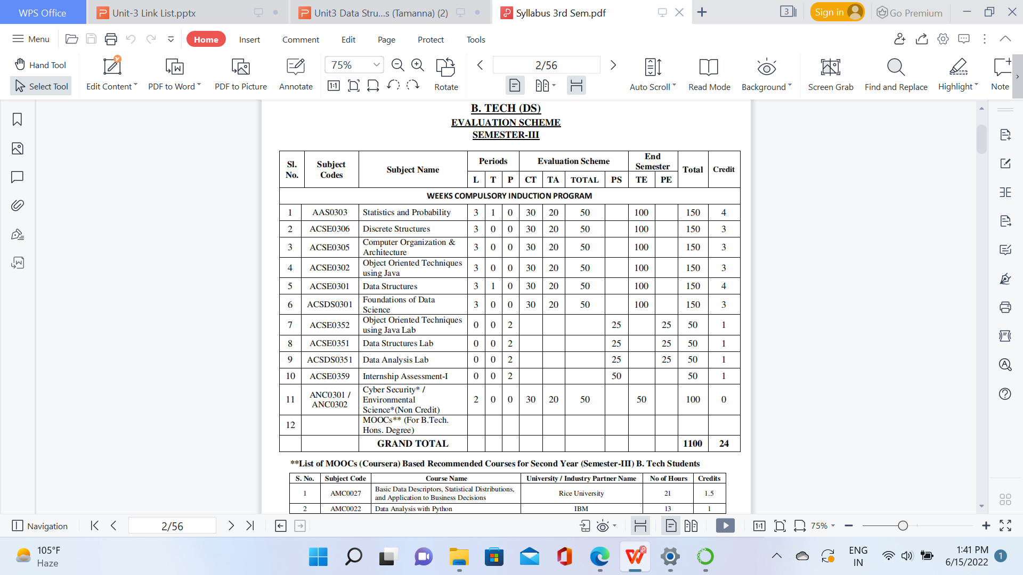
Evaluation Scheme

Slide 4
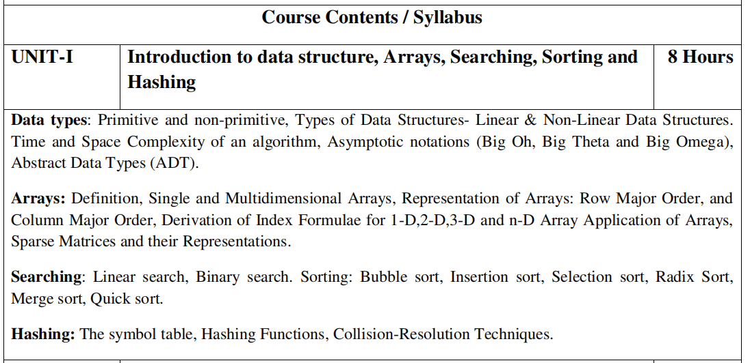
Syllabus

Slide 5
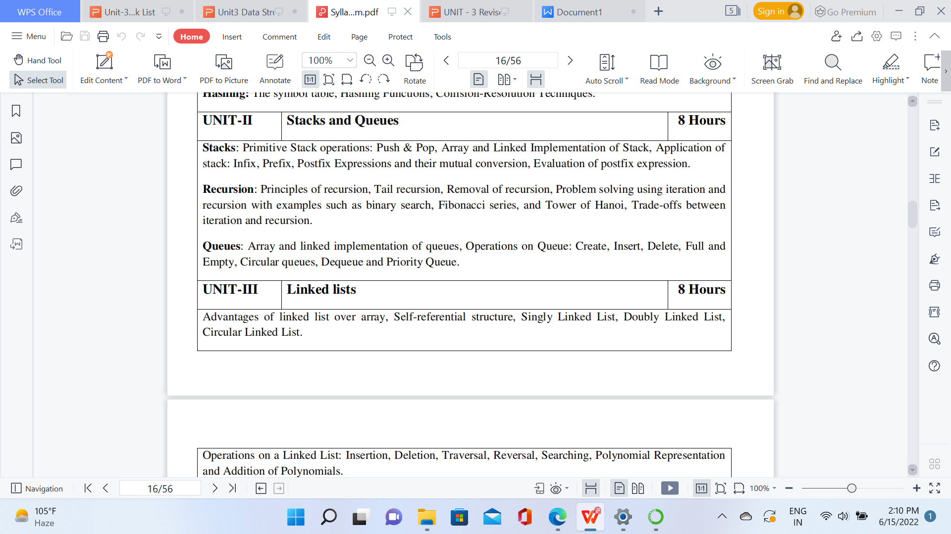
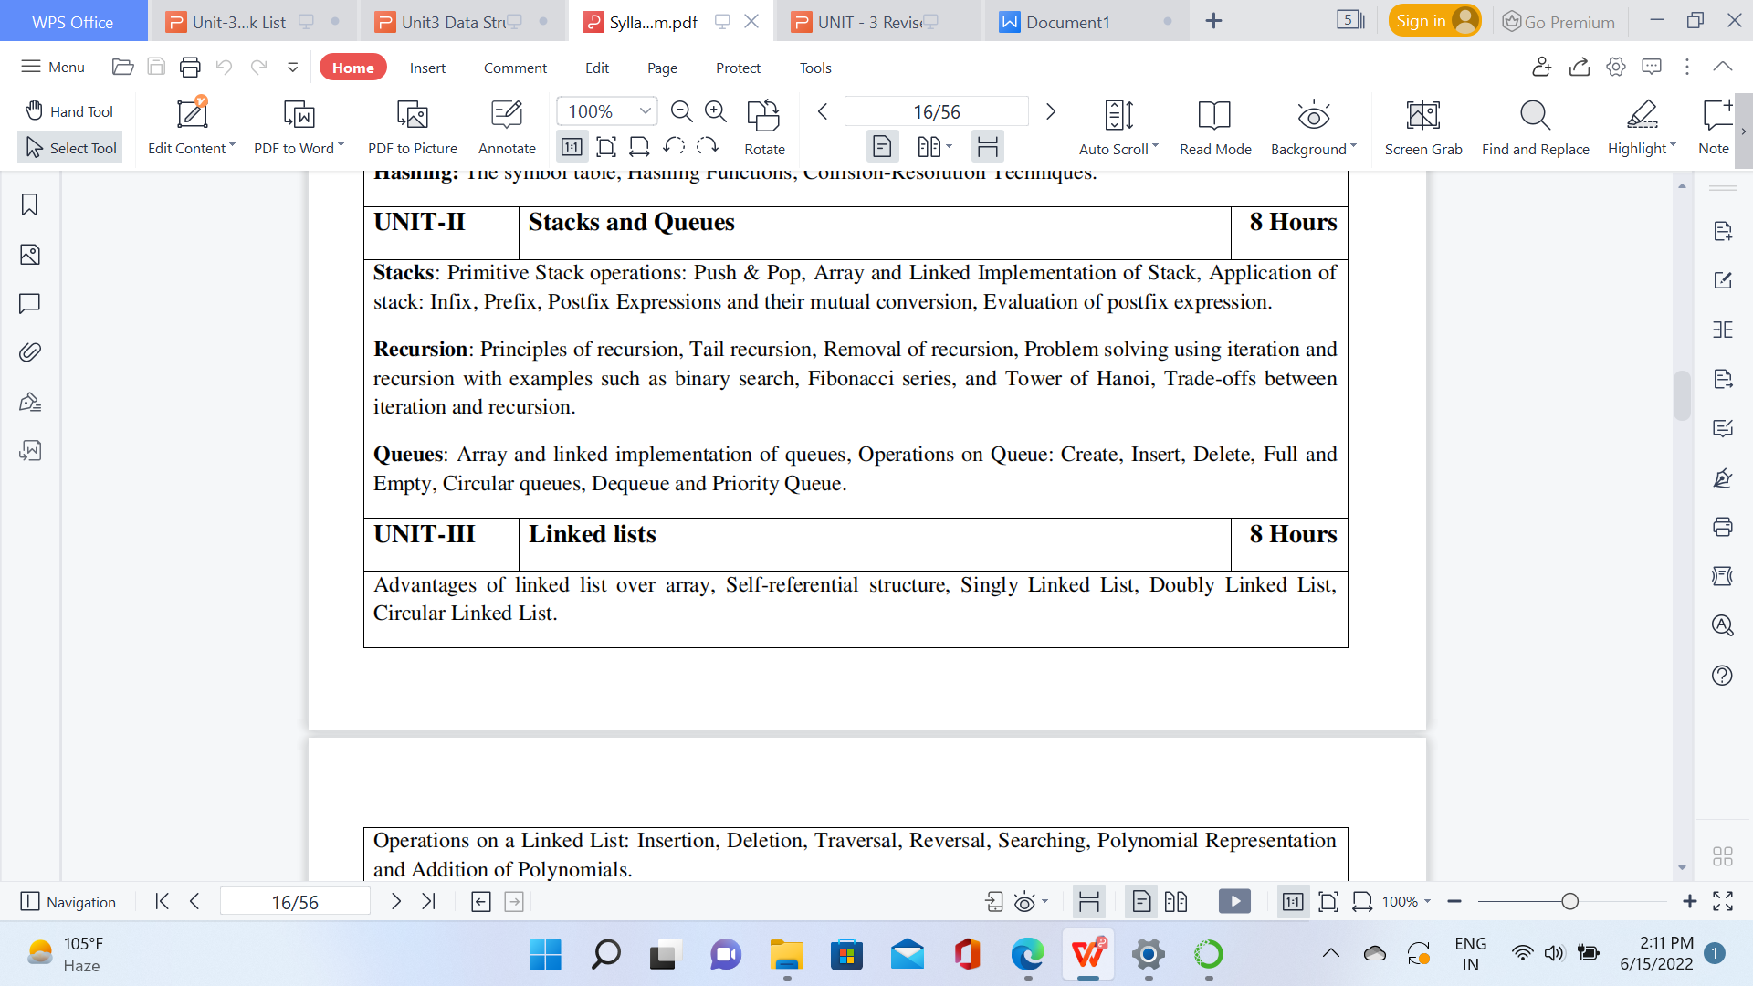
Syllabus

Slide 6
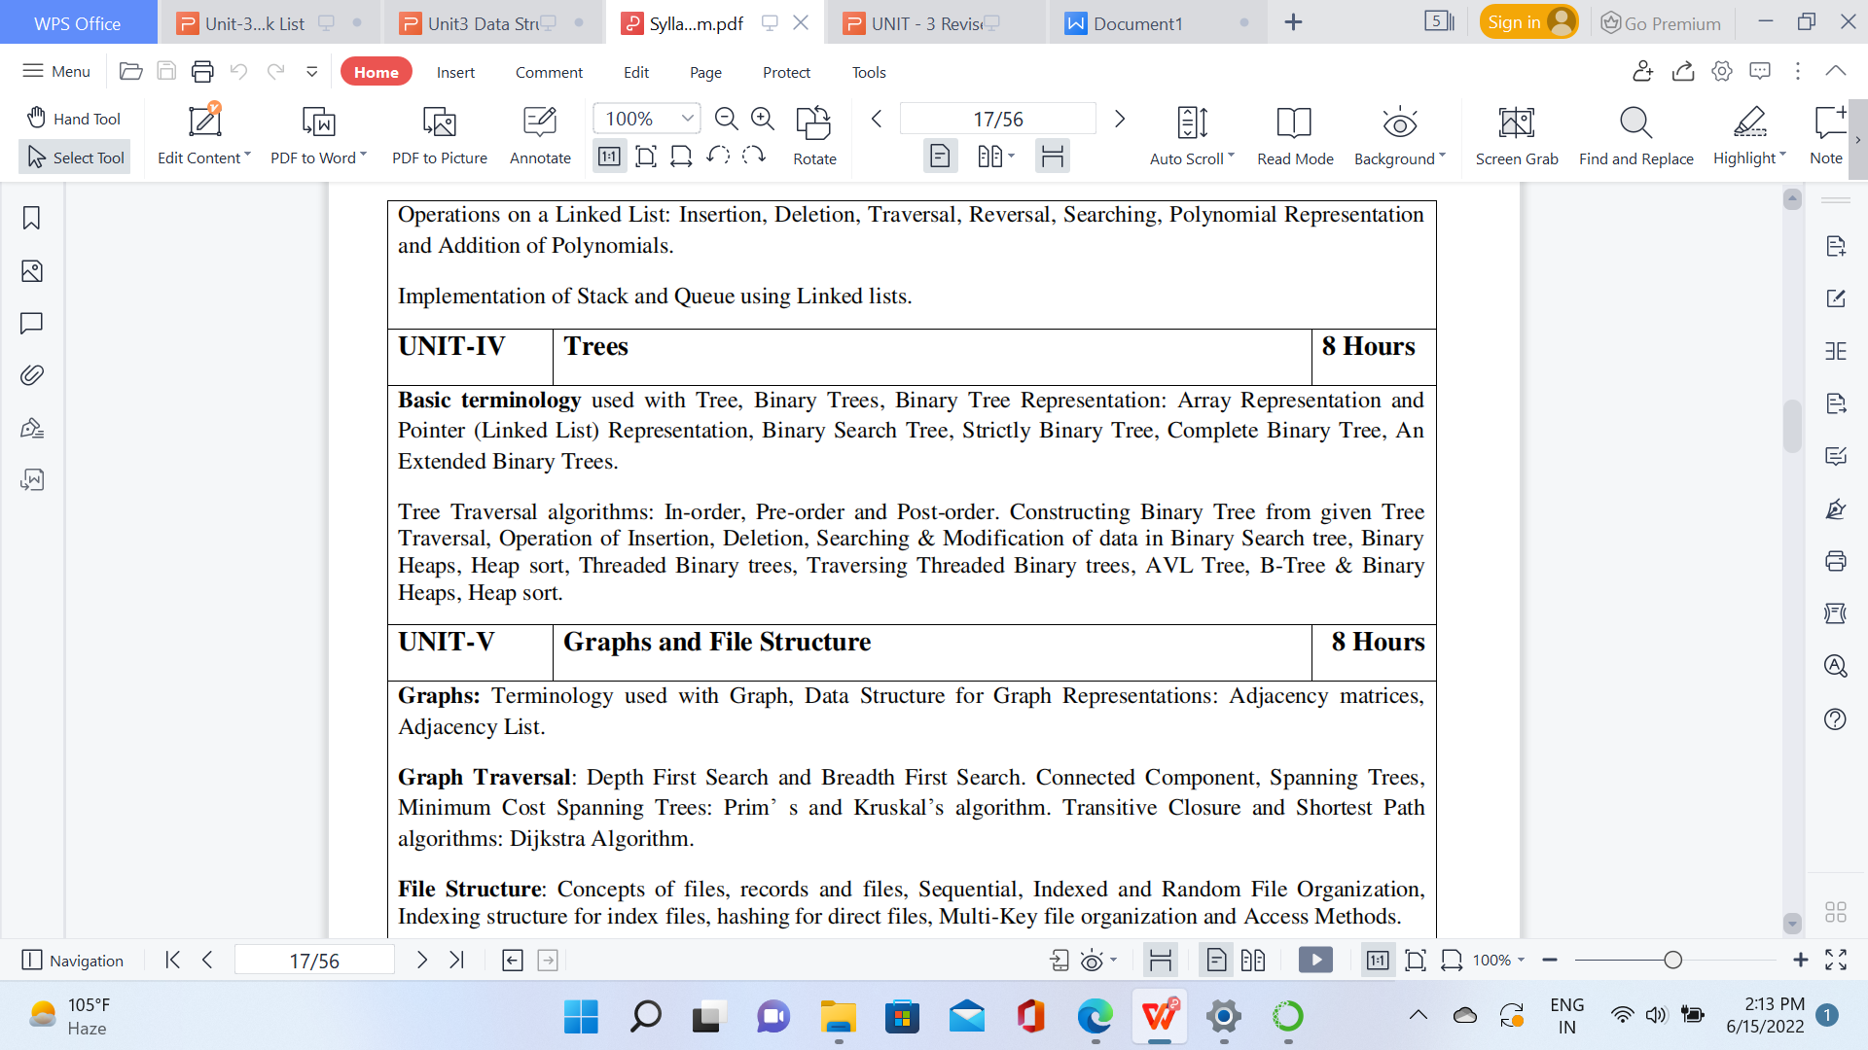
Syllabus

Slide 7
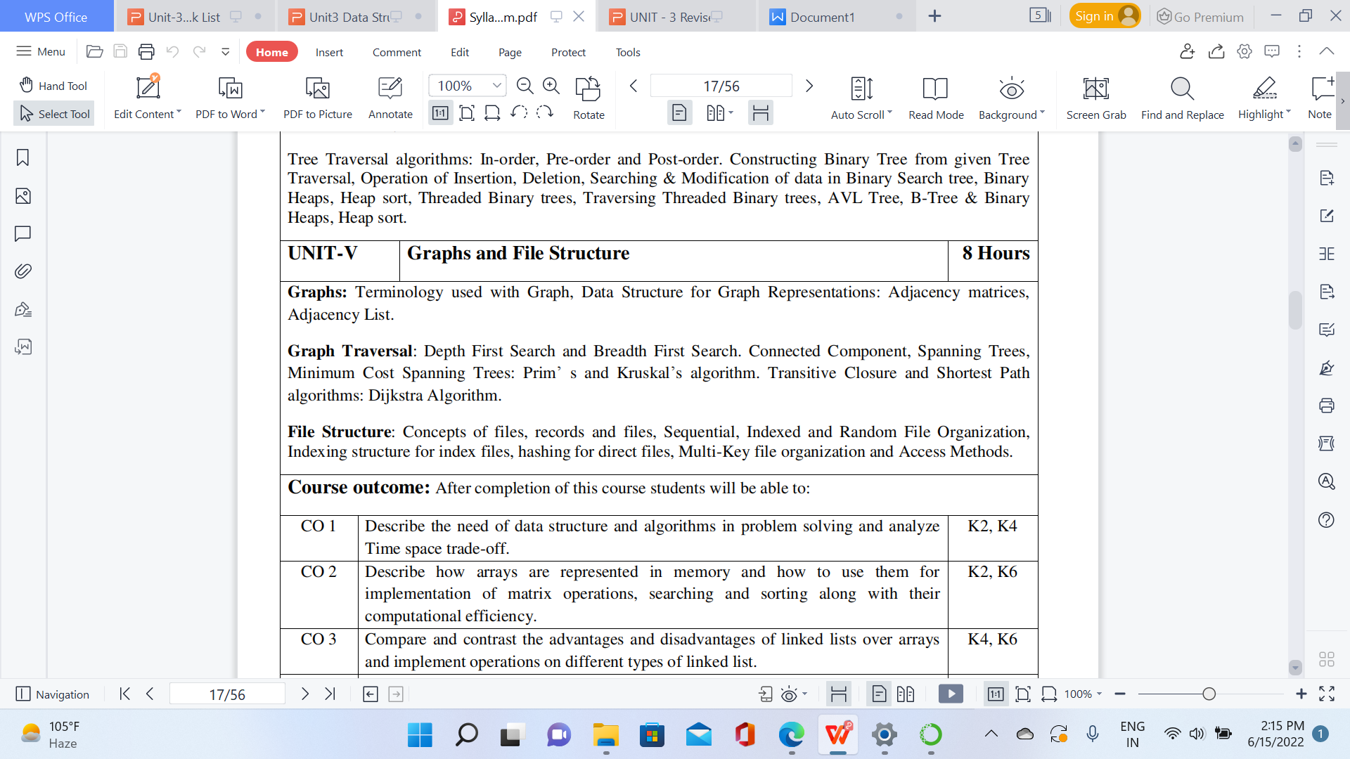
Syllabus

Slide 8
Syllabus
UNIT-2
Stacks: Abstract Data Type, Primitive Stack operations: Push & Pop , Array and Linked Implementation of Stack in C, Application of stack: Prefix and Postfix Expressions, Evaluation of postfix expression,
Iteration and Recursion- Principles of recursion, Tail recursion, Removal of recursion Problem solving using iteration and recursion with examples such as binary search, Fibonacci numbers, and Hanoi towers. Tradeoffs between iteration and recursion.
Queues: Operations on Queue: Create, Add, Delete, Full and Empty, Circular queues, Array and linked implementation of queues in C, Dequeue and Priority Queue.

Slide 9
Contents
Topics | Duration (in Hours)
Stacks: Abstract Data Type | 1
Array and Linked Implementation of Stack in C | 1
Application of stack: Prefix and Postfix Expressions | 1
Evaluation of postfix expression | 1
Iteration and Recursion- Principles of recursion | 1
Binary search using recursion | 1
Hanoi towers | 1
Tradeoffs between iteration and recursion. | 2

Slide 10
Contents
Topics | Duration (in Hours)
Queues: Operations on Queue | 1
Circular queues | 1
Array and linked implementation of queues in C | 1
Dequeue | 1
Priority Queue | 1

Slide 11
Objective of Unit
Objective of the course is to make students able to:
Learn the basic types for data structure, implementation and application.
Know the strength and weakness of different data structures.
3. Use the appropriate data structure in context of solution of given problem.
4. Develop programming skills which require to solve given problem.

Slide 12
Course Outcome
CO2: Describe how stacks, queues, are represented in memory, and identify the alternative implementations of data structures with respect to its performance to solve a real world problem.

Slide 13
CO-PO Mapping
Sr. No | Course Outcome | PO1 | PO2 | PO3 | PO4 | PO 5 | PO 6 | PO7 | PO8 | PO 9 | PO1 0 | PO1 1 | PO1 2
1 | CO 2 | 2 | 1 | 3 | 3 | 2 | 2 | 1 | 1 | 3 | 1 | 1 | 2

Slide 14
CO-PSO Mapping
Sr. No | Course Outcome | PSO 1 | PSO 2 | PSO 3 | PSO 4
1 | CO 2 | 2 | 2 | 3 | 2

Slide 15
Prerequisite and Recap
Stack is a container of objects that are inserted and removed according to the last-in first-out (LIFO) principle.
Queue is a container of objects (a linear collection) that are inserted and removed according to the first-in first-out (FIFO) principle.

Slide 16
Stack and Queue(CO2)
Topic mapping with Course Outcome
Topic | CO1 | CO2 | CO3 | CO4 | CO5
Stack | - | 2 | - | - | -
Queue | - | 2 | - | - | -

Slide 17
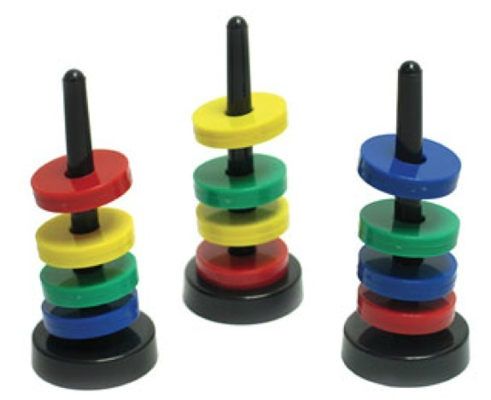
Stack
Introduction to Stack
A stack is a data structure in which items can be inserted only from one end and get items back from the same end.
There , the last item inserted into stack, is the the first item to be taken out from the stack. In short its also called Last in First out [LIFO].

Slide 18

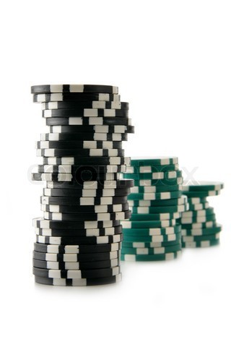
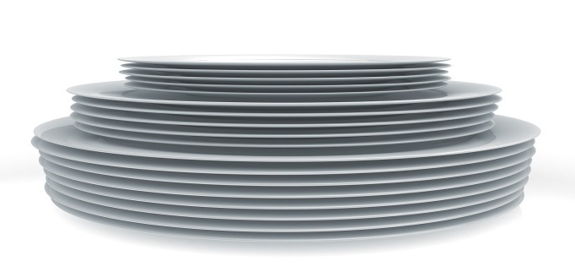
Example of Stack (LIFO)
Introduction to Stack
●
A Stack of book on table.
●
Token stack in Bank.
Stack of trays and plates.
●

Slide 19
Stack Operations
Introduction to Stack
Top: Open end of the stack is called Top, From this end item can be inserted.
Push: To insert an item from Top of stack is called push operation. The push operation change the position of Top in stack.
POP: To put-off, get or remove some item from top of the stack is the pop operation, We can POP only only from top of the stack.

Slide 20
Stack Operations
Introduction to Stack
IsEmpty: Stack considered empty when there is no item on Top. IsEmpty operation return true when no item in stack else false.
IsFull: Stack considered full if no other element can be inserted on top of the stack. This condition normally occur when stack implement ed through array.

Slide 21
Stack Abstract Data Type
Introduction to Stack
ADT Stack {
Data/Attributes/Values:
int size; Top Type items;
Functions/Operations:
CreateStack (int size); --create stack of size Void Push(int n); - - if stack is not full
Type Pop(); - - if stack is not empty return top item Int isEmpty(); - - return true if empty otherwise false Int isFull(); - - return true if full otherwise false }

Slide 22
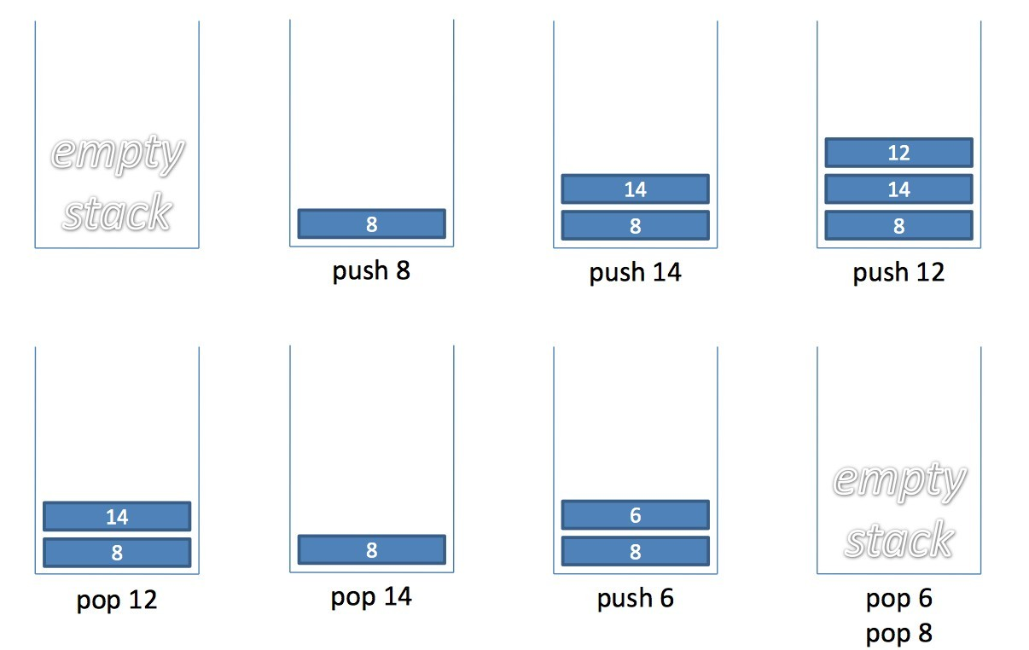
Stack Example
Introduction to Stack

Slide 23
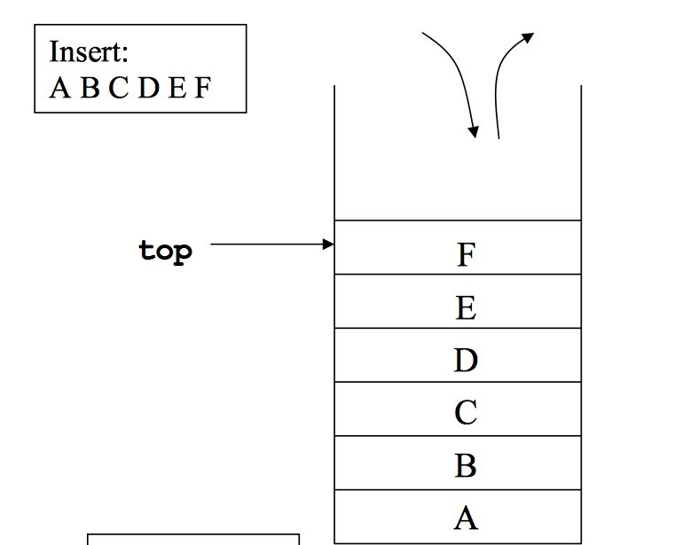
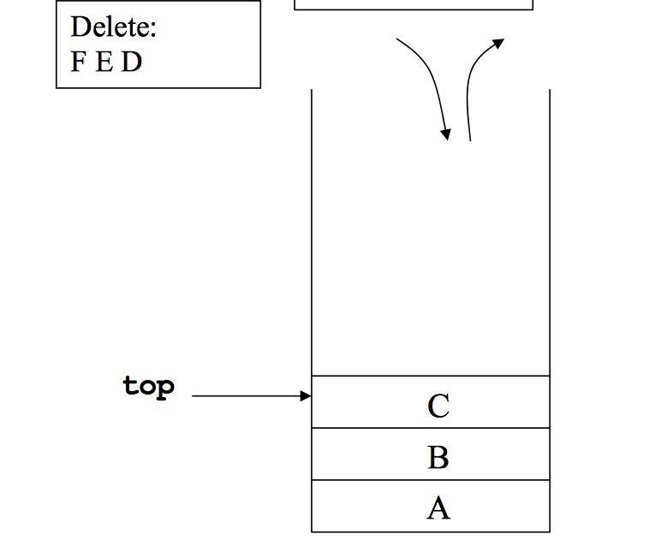
Introduction to Stack
Implementation of Stack
Using Array
Using Link List

Slide 24
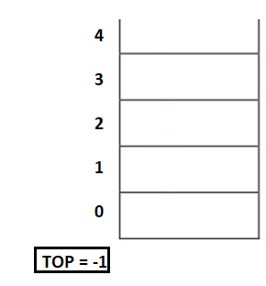
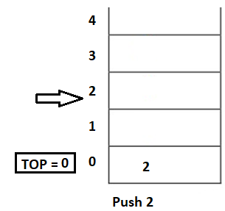
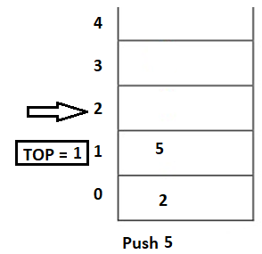
Stack Implementation using Array ...
Introduction to Stack

Slide 25
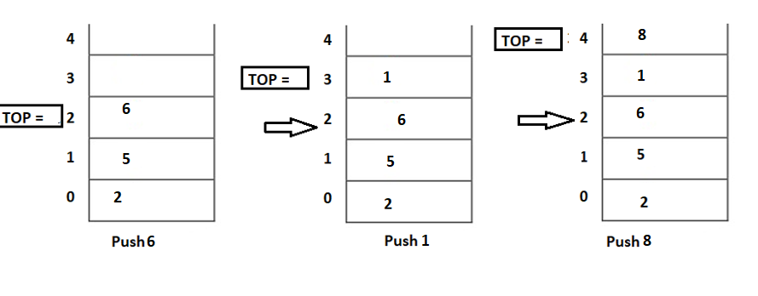
Introduction to Stack

Slide 26
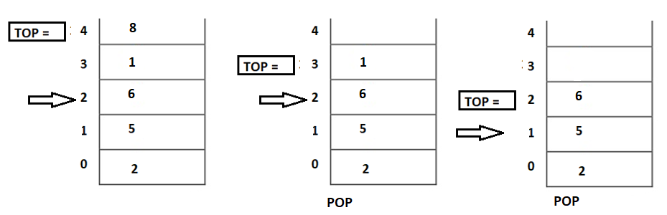
Introduction to Stack

Slide 27
Stack Implementation using Array
Introduction to Stack
A stack can be implemented using array as follows...
Before implementing actual operations, first follow the below steps to create an empty stack.
Step 1 - Include all the header files which are used in the program and define a constant 'SIZE' with specific value.
Step 2 - Declare all the functions used in stack implementation.
Step 3 - Create a one dimensional array with fixed size (int stack[SIZE])
Step 4 - Define a integer variable 'top' and initialize with '-1'. (int top = -1)
Step 5 - In main method, display menu with list of operations and make suitable function calls to perform operation selected by the user on the stack.

Slide 28
Stack Implementation using Array
Introduction to Stack
A=[]
While true
Choice=int(input(‘1 Push\n2.Pop\n3.Peek\n4.Display\n5.Exit\n Enter Choice”)
If choice==1:
Val=int(input(Enter Number to be pushed”))
Push(a,val)
Elif choice==2:
If Len(a)==0
Printf(“Empty Stack”)
Else:
Popitem(a)

Slide 29
Stack Implementation using Array
Introduction to Stack
Elif choice==3:
If len(a)==0:
Print(“EMPTY STACK”)
Else:
Peek(a)
Elif choice==5:
If len(a)=0
Print(“EMPTY STACK”)
Else
Display(a)
Else:
break;

Slide 30
Stack Implementation using Array
Introduction to Stack
Def push(a,val)
a.append(val)
print(“Element Inserted”)
def popitem(a)
val=a.pop()
printf(“Popped item”,val)
def peek(a)
index=len(a)-1
print(“PEEKED ELEMENT”, a[index])
display(a)
for I in range(len(a)-1,-1,-1):
print(a[i])

Slide 31
push(value) - Inserting value into the stack using array
Introduction to Stack
In a stack, push() is a function used to insert an element into the stack. In a stack, the new element is always inserted at top position. Push function takes one integer value as parameter and inserts that value into the stack. We can use the following steps to push an element on to the stack...
Step 1 - Check whether stack is FULL. (top == SIZE-1)
Step 2 - If it is FULL, then display "Stack is FULL!!! Insertion is not possible!!!" and terminate the function.
Step 3 - If it is NOT FULL, then increment top value by one (top++) and set stack[top] to value (stack[top] = value).

Slide 32
Introduction to Stack
pop() - Delete a value from the Stack using array
In a stack, pop() is a function used to delete an element from the stack. In a stack, the element is always deleted from top position. Pop function does not take any value as parameter. We can use the following steps to pop an element from the stack...
Step 1 - Check whether stack is EMPTY. (top == -1)
Step 2 - If it is EMPTY, then display "Stack is EMPTY!!! Deletion is not possible!!!" and terminate the function.
Step 3 - If it is NOT EMPTY, then delete stack[top] and decrement top value by one (top--).

Slide 33
Introduction to Stack
display() - Displays the elements of a Stack using array
We can use the following steps to display the elements of a stack...
Step 1 - Check whether stack is EMPTY. (top == -1)
Step 2 - If it is EMPTY, then display "Stack is EMPTY!!!" and terminate the function.
Step 3 - If it is NOT EMPTY, then define a variable 'i' and initialize with top. Display stack[i] value and decrement i value by one (i--).
Step 3 - Repeat above step until i value becomes '0'.

Slide 34
Introduction to Stack
stack = []
stack.append('a')
stack.append('b')
stack.append('c')
print('Initial stack')
print(stack)
# pop() function to pop element from stack in LIFO order
print('\nElements popped from stack:')
print(stack.pop())
print(stack.pop())
print(stack.pop())
print('\nStack after elements are popped:')
print(stack)
# uncommenting print(stack.pop()) will cause an IndexError as the stack is now empty

Slide 35
Stack Implementation using Link List
Introduction to Stack
The major problem with the stack implemented using an array is, it works only for a fixed number of data values.
Stack implemented using an array is not suitable, when we don't know the size of data which we are going to use.
Stack implemented using linked list works for the variable size of data.
So, there is no need to fix the size at the beginning of the implementation.

Slide 36
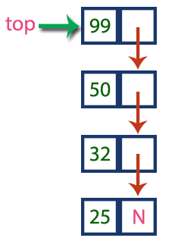
Stack Implementation using Link List
Introduction to Stack
In linked list implementation of a stack, every new element is inserted as 'top' element. That means every newly inserted element is pointed by 'top’.
Whenever we want to remove an element from the stack, simply remove the node which is pointed by 'top' by moving 'top' to its previous node in the list. The next field of the first element must be always NULL.

Slide 37
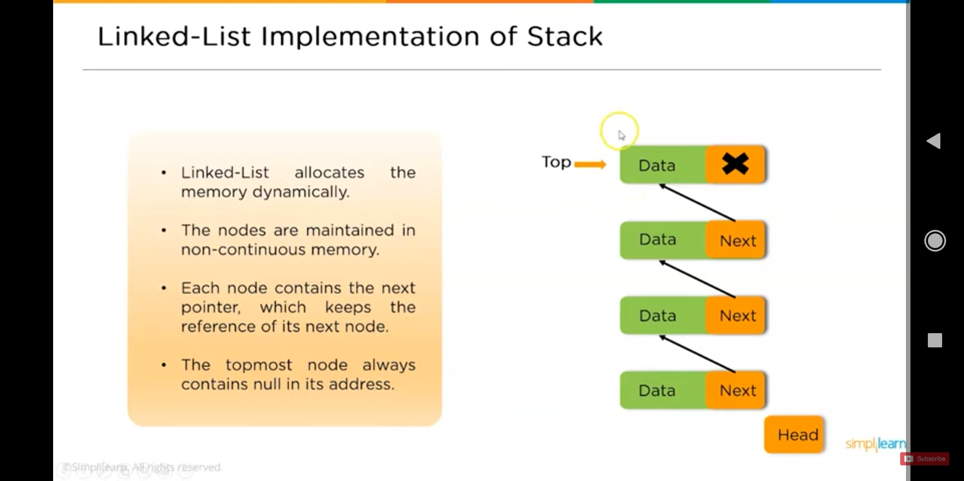
Introduction to Stack

Slide 38
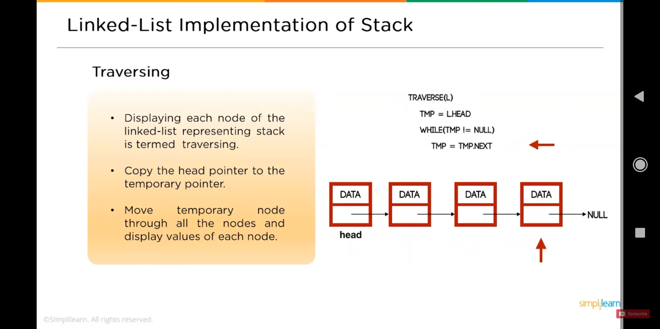
Introduction to Stack

Slide 39
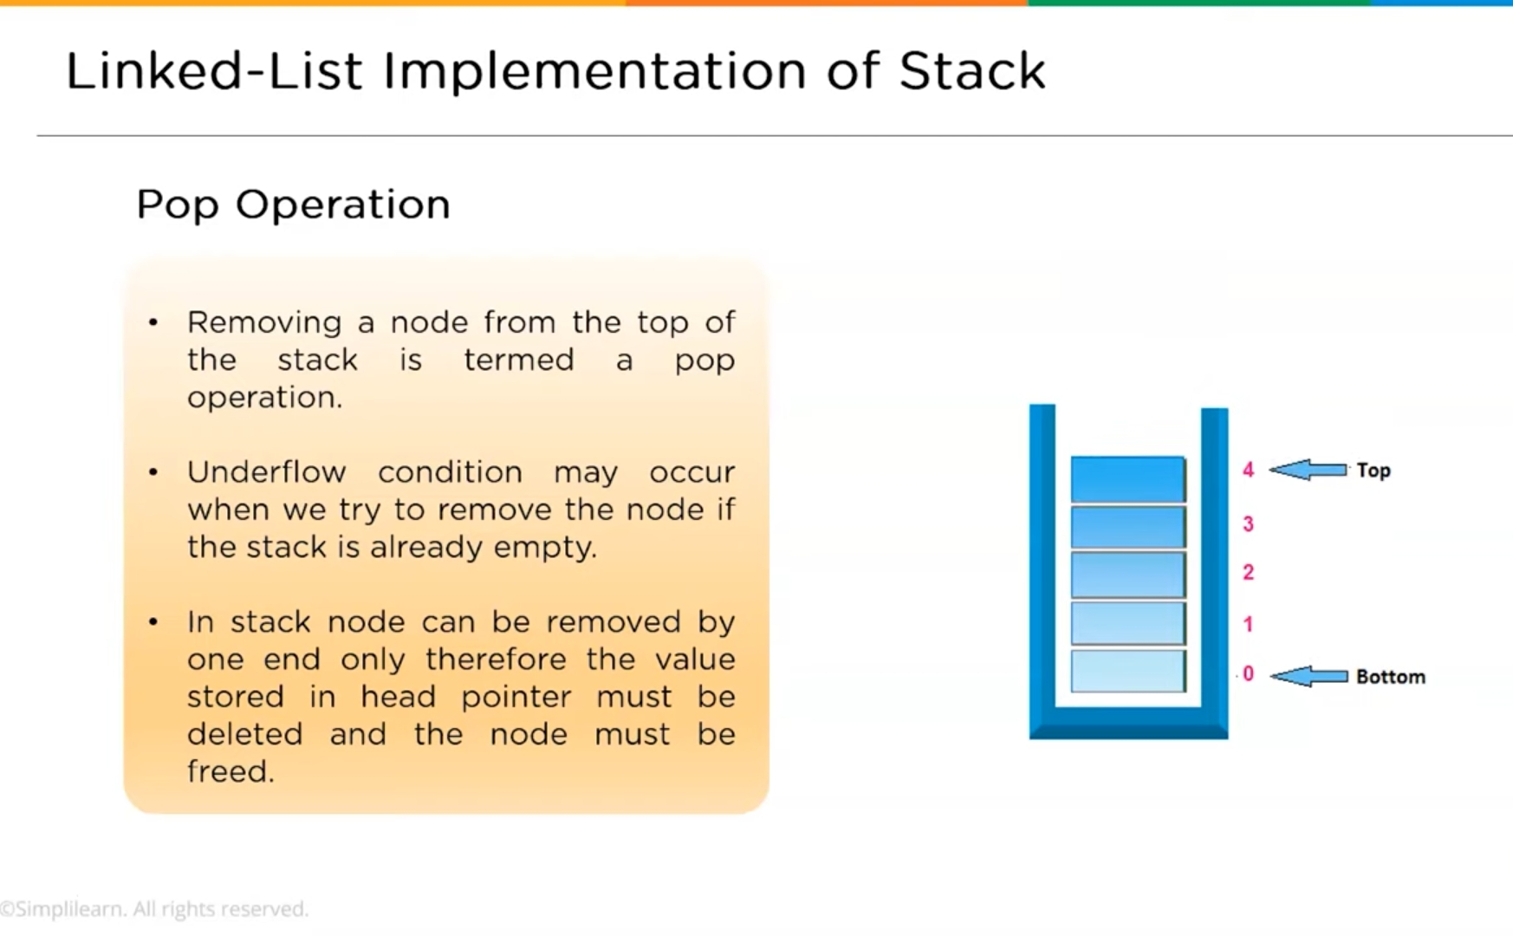
Introduction to Stack

Slide 40
Introduction to Stack
Def push(self,data):
Newnode=node(data)
Newnode.next=self.head
Self.head=newnode
Self.length=self.length+1
Def pop(self):
If self.length==0:
Print(“Stack Empty”)
Return none Else
Item=self.head
Self.head=self.head.next
Self.length=self.length-1
Item.next=none
Return self.item.data
Class node:
Def__init__(self,data)
Self.data=data
Self.next=None
Class Stack :
Def__init__(self) :
Self.head=none
Self.length=0

Slide 41
Introduction to Stack
def peek(self):
If self.length==0
Print(“Stack empty”)
Return none
Else
Print(self.head.data)
Def isempty(self):
Return self.length==0
Def size(self):
Return self.length

Slide 42
Introduction to Stack
Stk=stack()
Print(“is stack empty” stk.isempty())
Stk.push(‘Data-First’)
Stk.push(‘Data-new’)
Print(‘Stack Size’ stk.size)
Stk.push(10)
Print(‘Peek ‘ , stk.peek())
Print(‘Stack Size’ stk.size)
Print(“is stack empty” stk.isempty())

Slide 43
Stack Implementation using Link List
Introduction to Stack
To implement a stack using a linked list, we need to set the following things before implementing actual operations.
Step 1 - Include all the header files which are used in the program. And declare all the user defined functions.
Step 2 - Define a 'Node' structure with two members data and next.
Step 3 - Define a Node pointer 'top' and set it to NULL.
Step 4 - Implement the main method by displaying Menu with list of operations and make suitable function calls in the main method.

Slide 44
Introduction to Stack
push(value) - Inserting an element into the Stack using Link List
We can use the following steps to insert a new node into the stack...
Step 1 - Create a newNode with given value.
Step 2 - Check whether stack is Empty (top == NULL)
Step 3 - If it is Empty, then set newNode → next = NULL
.
Step 4 - If it is Not Empty, then set newNode → next = top.
Step 5 - Finally, set top = newNode.

Slide 45
Introduction to Stack
pop() - Deleting an Element from a Stack using Link List
We can use the following steps to delete a node from the stack...
Step 1 - Check whether stack is Empty (top == NULL).
Step 2 - If it is Empty, then display "Stack is Empty!!! Deletion is not possible!!!" and terminate the function
Step 3 - If it is Not Empty, then define a Node pointer 'temp' and set it to 'top’.
Step 4 - Then set 'top = top → next’.
Step 5 - Finally, delete 'temp'. (free(temp)).

Slide 46
Introduction to Stack
display() - Displaying stack of elements using Link List
We can use the following steps to display the elements (nodes) of a stack...
Step 1 - Check whether stack is Empty (top == NULL).
Step 2 - If it is Empty, then display 'Stack is Empty!!!' and terminate the function.
Step 3 - If it is Not Empty, then define a Node pointer 'temp' and initialize with top.
Step 4 - Display 'temp → data --->' and move it to the next node. Repeat the same until temp reaches to the first node in the stack. (temp → next != NULL).
Step 5 - Finally! Display 'temp → data ---> NULL'.

Slide 47
Stack Application
Introduction to Stack
Reversing a string: To reverse a string we can use following algorithm.
Given the sting and a stack
While there is not end of string, do the following.
Read a character form the string
Push it on the stack
End while
Re-initialize string position
While stack is not Empty, do the following.
Pop a character from the stack
Insert the character popped into next position in string.
End While

Slide 48
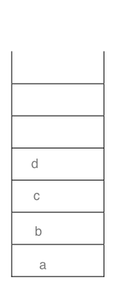
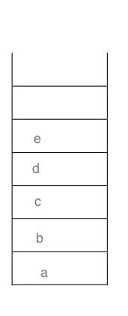
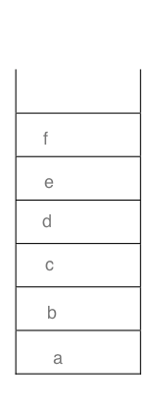
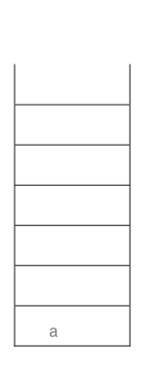
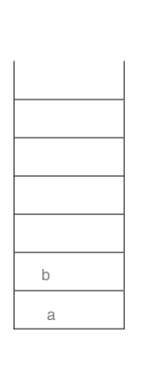
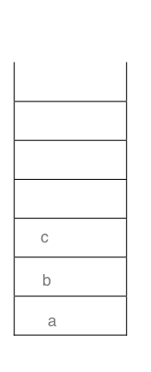
Reverse String...
Introduction to Stack
String is a b c d e f PUSH to SACK

Slide 49
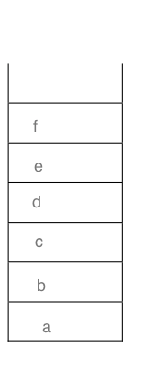
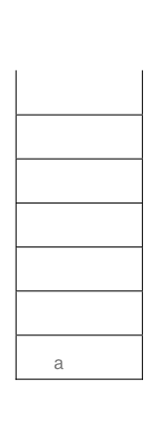
Reverse String...
Introduction to Stack
Reversed String: f e d c b a POP from SACK

Slide 50
Introduction to Stack
What is an Expression?
In any programming language, if we want to perform any calculation or to frame a condition etc., we use a set of symbols to perform the task. These set of symbols makes an expression. An expression can be defined as follows...
An expression is a collection of operators and operands that represents a specific value.
In above definition, operator is a symbol which performs a particular task like arithmetic operation or logical operation or conditional operation etc.,
Operands are the values on which the operators can perform the task. Here operand can be a direct value or variable or address of memory location

Slide 51
Introduction to Stack
Expression Types
Based on the operator position, expressions are divided into THREE types. They are as follows...
Infix Expression
Postfix Expression
Prefix Expression

Slide 52
Infix, Postfix and Prefix Expression
Introduction to Stack
Infix Expression: An expression in which the
operator is in between its two operands.
A+B
Prefix Expression: An expression in which operator precedes its two operands is called an prefix expression.
+AB
An expression in which
Postfix Expression:
operator follows its two operands is called a postfix expression.
AB+

Slide 53
Infix to Postfix Conversion
Introduction to Stack
Infix expression can be directly evaluated but the standard practice in CS is that the infix expression converted to postfix form and then the expression is evaluated.
During both processes stack is proved to be a useful data structure.

Slide 54
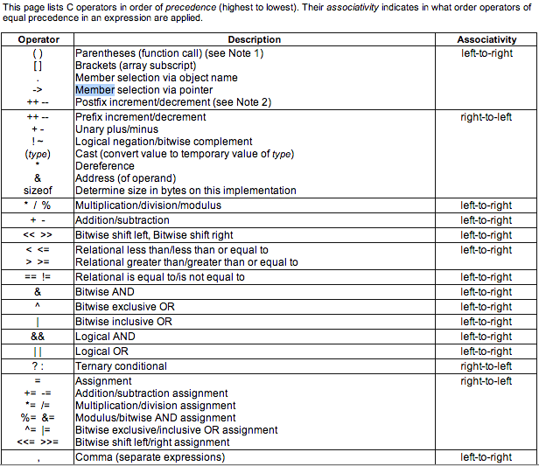
C language operators Precedence and Associativity
Introduction to Stack

Slide 55
Infix to Postfix By-Hand Algorithm
Introduction to Stack
Given a expression in the infix form.
Find the highest precedence operator
If there are more then one operators with the same precedence check associativity, i.e. pick the left most first.
Convert the operator and its operands from infix to postfix
(A + B) → A B+
Repeat steps 2 to 4, until all the operators in the given expression are in the postfix form.

Slide 56
Introduction to Stack
Q1. Convert the given infix expression 2*3/(2-1)+5*(4-1) to postfix expression
Sol.
Enclosed in brackets, based on precedence and associativity
2*3/(2-1)+5*(4-1)
(2*3)/(2-1)+5*(4-1)
((2*3)/(2-1))+(5*(4-1))
((2*3)/(2-1))+(5*(4-1))
((2*3)/(2-1))+(5*(4-1))
(((2*3)/(2-1))+(5*(4-1)))

Slide 57
Introduction to Stack
2. Convert each bracket in postfix expression one by one
a. (((2*3)/(2-1))+(5*(4-1)))
b. (((23*)/(2-1))+(5*(4-1)))
c. (((23*)/(21-))+(5*(4-1)))
d. (((23*)/(21-))+(5*(41-)))
e. (((23*)(21-)/)+(5*(41-)))
f. (((23*)(21-)/)+(5(41-)*))
f. (((23*)(21-)/)(5(41-)*)+)
Ans. 23*21-/541-*+
H.W
1. A+B*C-D^E^F

Slide 58
Infix to Prefix By-Hand Algorithm
Introduction to Stack
Given a expression in the infix form.
Find the highest precedence operator
If there are more then one operators with the same precedence check associativity, i.e. pick the left most first.
Convert the operator and its operands from infix to prefix A + B --> +A B
Repeat steps 2 to 4, until all the operators in the given expression are in the postfix form.

Slide 59
Infix to Prefix Step by Step Conversion
Introduction to Stack
Q1. A*B+C/D (Infix)
((A*B)+(C/D))
*AB+C/D
*AB+/CD
+*AB/CD (Prefix)
Q2. A*(B+C/D)
(A*(B+(C/D)) )
A*(B+/CD)
A*(+B/CD)
*A+B/CD
Exercise:
1. Infix ( (A * B) + (C / D) ) to Prefix
2.Infix ((A * (B + C) ) / D) to Prefix
3.Infix (A * (B + (C / D) ) ) to Prefix

Slide 60
Infix to Postfix using Stack (Convert in Reverse Polish Notation)
Introduction to Stack
Examine the given Input Sequence.
If it is operand output it.
If it is ‘(‘ push it on the stack.
If it is an operator and
If the stack is empty push it on the stack.
If the top of the stack is ‘(‘ then push it on to the stack.
If it has higher priority then top of the stack, push it on to the stack.
Otherwise pop operator from the stack and output it. And go to step 4.
If it is ‘)’ then pop of the operators from the stack and output them until ‘(‘ is encountered.
If there are more input sequence then go to step 1.
If there are no more input sequence, pop of remaining elements from the stack and output them.

Slide 61
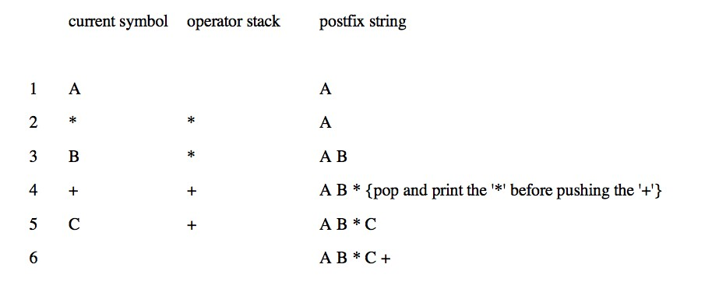
Introduction to Stack
Infix to Postfix using stack
●
Example A*B+C become AB*C+

Slide 62
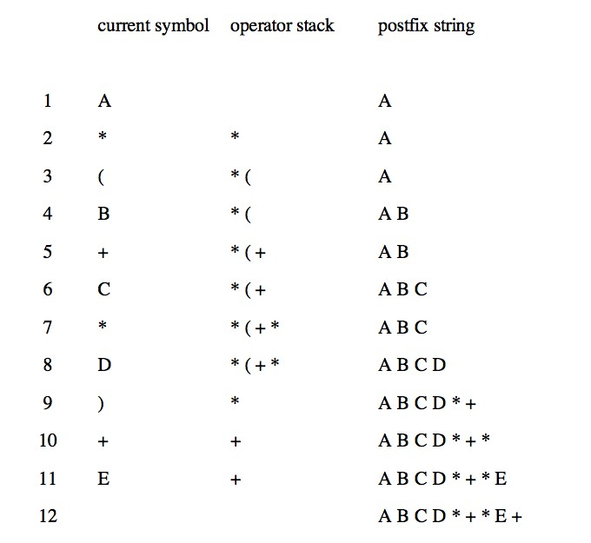
Introduction to Stack
Infix to Postfix using stack ...
Example A * (B + C * D) + E becomes A B C D * + * E +

Slide 63
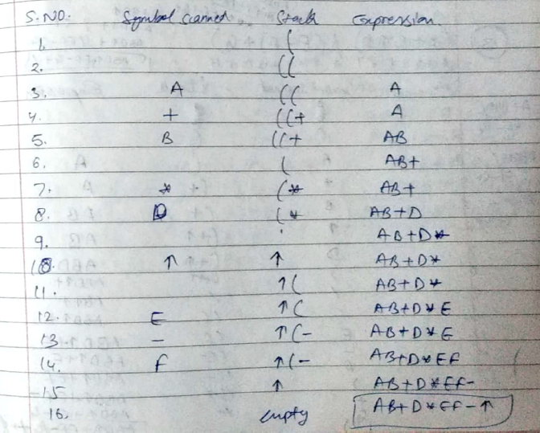
Introduction to Stack
((A+B)*D)^(E-F))

Slide 64
Introduction to Stack
Infix to Prefix using Stack (Convert in Polish Notation)
First, reverse the given infix expression.
Scan the characters one by one.
If the character is an operand, print it .
If the character is a closing parenthesis, then push it to the stack.
If the character is an opening parenthesis, pop the elements in the stack until we find the corresponding closing parenthesis.
If the character scanned is an operator
If the operator has precedence greater than or equal to the top of the stack, push the operator to the stack.
If the operator has precedence lesser than the top of the stack, pop the operator and output it to the prefix notation output and then check the above condition again with the new top of the stack.
7. After all the characters are scanned, reverse the prefix notation output

Slide 65
Infix to Prefix using Stack..
Introduction to Stack
Step 1: Reverse the infix expression i.e A+B*C will become C*B+A. Note while reversing each ‘(‘ will become ‘)’ and each ‘)’ becomes ‘(‘.
Step 2: Obtain the postfix expression of the modified expression i.e CB*A+.
Step 3: Reverse the postfix expression. Hence in our example prefix is +A*BC.

Slide 66
Introduction to Stack
Algorithm for Prefix
This is how you convert manually for theory question in the exam
Input String - Infix – ((a/b)+c)-(d+(e*f))
String after reversal – ))f*e(+d(-)c+)b/a((
Apply postfix
Reverse Postfix Expression (Given After the table below)

Slide 67
Introduction to Stack
Infix – ((a/b)+c)-(d+(e*f)) → ))f*e(+d(-)c+)b/a((
Sr. no. | Expression | Stack | Prefix
0 | ) | )
1 | ) | ))
2 | f | )) | f
3 | * | ))* | f
4 | e | ))* | fe
5 | ( | ) | fe*
6 | + | )+ | fe*
7 | d | )+ | fe*d
8 | ( |  | fe*d+
9 | – | - | fe*d+
10 | ) | -) | fe*d+
11 | c | -) | fe*d+c
12 | + | -)+ | fe*d+c
13 | ) | -)+) | fe*d+c
14 | b | -)+) | fe*d+cb
15 | / | -)+)/ | fe*d+cb
16 | a | -)+)/ | fe*d+cba
17 | ( | -)+ | fe*d+cba/
18 | ( | - | fe*d+cba/+
19 |  |  | fe*d+cba/+- -+/abc+d*ef

Slide 68
Introduction to Stack
Infix – A*(B+D)/E-F*(G+H/K) --- > )K/H+G(*F-E/)D+B(*A
Sr. no. | Expression | Stack | Prefix
1 | ) | )
2 | K | ) | K
3 | / | )/ | K
4 | H | )/ | KH
5 | + | )+ | KH/
6 | G | )+ | KH/G
7 | ( |  | KH/G+
8 | * | * | KH/G+
9 | F | * | KH/G+F
10 | - | - | KH/G+F*
11 | E | - | KH/G+F*E
12 | / | -/ | KH/G+F*E
13 | ) | -/) | KH/G+F*E
14 | D | -/) | KH/G+F*ED
15 | + | -/)+ | KH/G+F*ED
16 | B | -/)+ | KH/G+F*EDB
17 | ( | -/ | KH/G+F*EDB+
18 | * | -/* | KH/G+F*EDB+
19 | A | -/* | KH/G+F*EDB+A
20 | - |  | KH/G+F*EDB+A*/-

Slide 69
Evaluating Arithmetic Postfix Expression
Introduction to Stack
1) Create a stack to store operands (or values). 2) Scan the given expression and do following for every scanned element. …..a) If the element is a number, push it into the stack …..b) If the element is a operator, pop two operands for the operator from stack. Evaluate the operator and push the result back to the stack 3) When the expression is ended, the number in the stack is the final answer

Slide 70
Evaluating Arithmetic Postfix Expression
Introduction to Stack
PostFix Expression 2 3 4 + * 5 *
Move | Token | Stack
1 | 2 | 2
2 | 3 | 2 3
3 | 4 | 2 3 4
4 | + | 2 7 (3+4=7)
5 | * | 14 (2*7=14)
6 | 5 | 14 5
7 | * | 70 (14*5=70)

Slide 71
Recursion
Introduction to Stack
Recursion is a process by which a function calls itself repeatedly, until some specified condition has been satisfied
The process is used for repetitive computations in which each action is stated in terms of a previous result.
To solve a problem recursively, two conditions must be satisfied.
First, the problem must be written in a recursive form
Second the problem statement must include a stopping condition
https://www.youtube.com/watch?v=hY1PGHB9xMY

Slide 72
Types of Recursions: Recursion are mainly of two types depending on whether a function calls itself from within itself or more than one function call one another mutually. The first one is called direct recursion and another one is called indirect recursion. fun() { ------------- ------------ ---------- fun() }
Introduction to Stack
Fun1()
{
Fun2()
}
Fun2()
{
Fun1()
}
https://www.youtube.com/watch?v=t9whckmAEq0

Slide 73
Introduction to Stack
Head Recursion()
Fun()
{
Fun();
…….
……
…….
}
Tail Recursion()
Fun()
{
…….
……
…….
Fun();
}
Head &Tail Recursion()
Fun()
{
Fun()
...….
……
…….
Fun();
}
https://www.youtube.com/watch?v=HIt_GPuD7wk

Slide 74
Recursion
Introduction to Stack
There is base condition, that stops further calling of the function
Function call itself directly or indirectly, it should reach towards base condition.

Slide 75
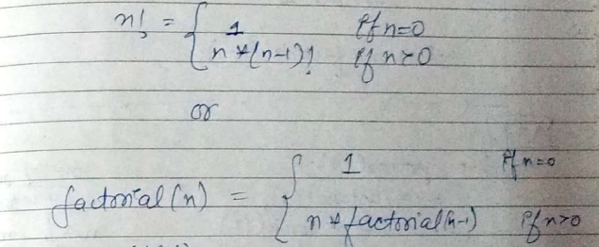
Calculate Factorial of the number using Recursion.
Introduction to Stack
factorial of n → (n!) = n * n-1 – n-2* ………*2*1
n!= n* (n-1)! And 0! = 1
https://www.youtube.com/watch?v=g3OEEztC1zQ&t=37s

Slide 76
Factorial of an integer number using recursive function
Introduction to Stack
def recur_factorial(n):
if n == 1:
return n
else:
return n*recur_factorial(n-1)
Factorial(5)=
5*Factorial(4)=
5*(4*Factorial(3))= 5*(4*(3*Factorial(2)=
5*(4*(3*(2*Factorial(1))))=
5*(4*(3*(2*(1*Factorial(0)))))=
5*(4*(3*(2*(1*1))))= 5*(4*(3*(2*1)))=
5*(4*(3*2))= 5*(4*6)= 5*24=
num = int(input("Enter the number: "))
# check if the number is negative
if num < 0:
print("Sorry, factorial does not exist for negative numbers")
elif num == 0:
print("The factorial of 0 is 1")
else:
print("The factorial of", num, "is", recur_factorial(num))
120

Slide 77
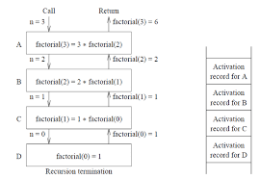
Factorial of an integer number using recursive function
Introduction to Stack
def recur_factorial(n):
if n == 1:
return n
else:
return n*recur_factorial(n-1)
num = int(input("Enter the number: "))
# check if the number is negative
if num < 0:
print("Sorry, factorial does not exist for negative numbers")
elif num == 0:
print("The factorial of 0 is 1")
else:
print("The factorial of", num, "is", recur_factorial(num))

Slide 78
Recursion
Program for Fibonacci numbers
The Fibonacci numbers are the numbers in the following integer sequence.
0, 1, 1, 2, 3, 5, 8, 13, 21, 34, 55, 89, 144, ……..
In mathematical terms, the sequence Fn of Fibonacci numbers is defined by the recurrence relation Fn = Fn-1 + Fn-2 with seed values F0 = 0 and F1 = 1.
https://www.youtube.com/watch?v=L5ID6qbgkhc

Slide 79
Recursion
def fib_num(n):
if n<=0:
print("Fibonacci can't be computed")
# First Fibonacci number
elif n==1:
return 0
# Second Fibonacci number
elif n==2:
return 1
else:
return fib_num(n-1)+fib_num(n-2)
#input
n=int(input("Enter n: "))
print("{}th Fibonacci number is ".format(n),fib_num(n))

Slide 80
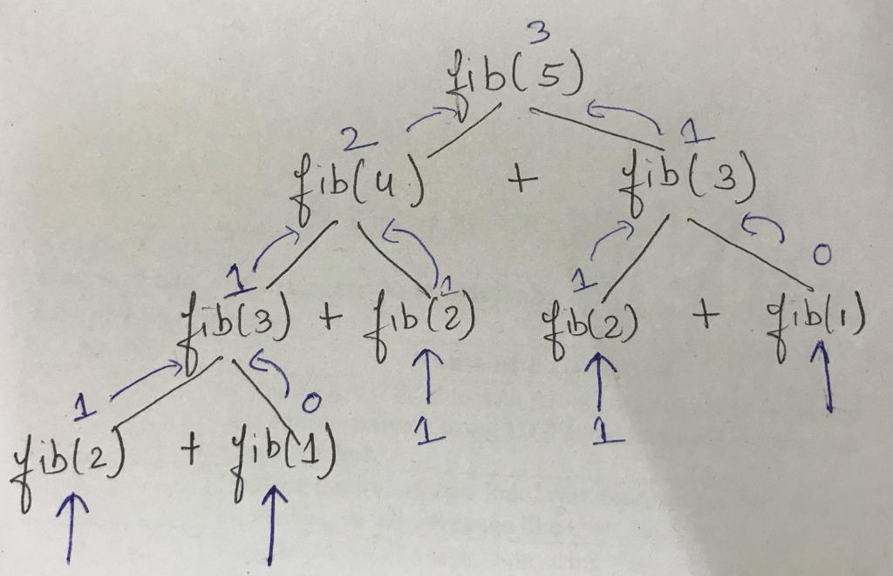
Recursion

Slide 81
Recursion Pros and Cons
Introduction to Stack
Pros
The code may be much easier to write.
To solve some problems which are naturally recursive such as tower of Hanoi.
Cons
Recursive functions are generally slower than non-recursive functions.
May require a lot of memory to hold intermediate results on the system stack.
It is difficult to think recursively so one must be very careful when writing
recursive functions.

Slide 82
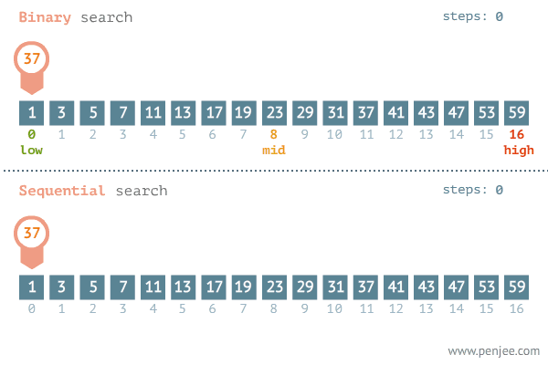
Recursion

Slide 83
Recursion
Binary Search Using Recursion
def binary_search(my_list, low, high, elem):
if high >= low:
mid = (high + low) // 2
if my_list[mid] == elem:
return mid
elif my_list[mid] > elem:
return binary_search(my_list, low, mid - 1, elem)
else:
return binary_search(my_list, mid + 1, high, elem)
else:
return -1

Slide 84
Recursion
my_list = [ 1, 9, 11, 21, 34, 54, 67, 90 ]
elem_to_search = 1
print("The list is")
print(my_list)
my_result = binary_search(my_list,0,len(my_list)-1,elem_to_search)
if my_result != -1:
print("Element found at index ", str(my_result))
else:
print("Element not found!")

Slide 85
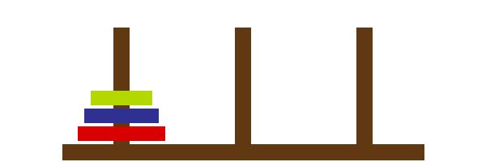
Tower of Hanoi Problem
Introduction to Stack
Tower of Hanoi is a mathematical puzzle where we have three rods and n disks.

Slide 86
Tower of Hanoi Problem
Introduction to Stack
The objective of the puzzle is to move the entire stack to another rod, obeying the following simple rules:
Only one disk can be moved at a time.
2) Each move consists of taking the upper disk from one of the stacks and placing it on top of another stack i.e. a disk can only be moved if it is the uppermost disk on a stack.
3) No disk may be placed on top of a smaller disk.

Slide 87
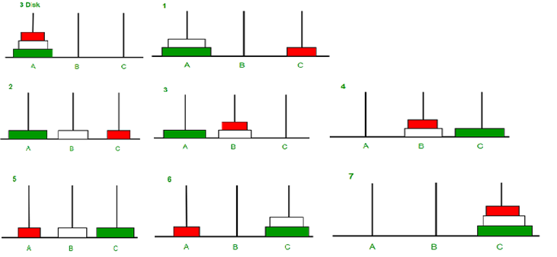
Tower of Hanoi Problem Illustration
Introduction to Stack

Slide 88
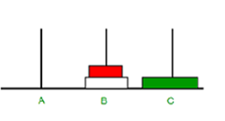
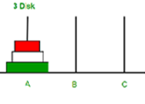
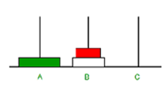
Tower of Hanoi Algorithm Concept
Introduction to Stack

Slide 89
A recursive algorithm for Tower of Hanoi can be driven as follows
Introduction to Stack
def TowerOfHanoi(n , source, destination, auxiliary):
if n==1:
print ("Move disk 1 from source",source,"to destination",destination)
return
TowerOfHanoi(n-1, source, auxiliary, destination)
print ("Move disk",n,"from source",source,"to destination",destination)
TowerOfHanoi(n-1, auxiliary, destination, source)
# Driver code
n = 3
TowerOfHanoi(n,'A','B','C')
# A, C, B are the name of rods

Slide 90
A recursive program in Python for Tower of Hanoi
Introduction to Stack
Def toh(numbers,start,aux,end):
If numbers==1:
Printf(“Move disk 1 from rod{} to rod{}”, format(start, end))
return
Toh(numbers-1,start,end,aux)
Print(:move disk {} from rod{} to rod{}” format(numbers,start,end))
Toh(numbers-1,aux,start,end)
Disc=3
Toh(disc,”a”,”b”,”c”)

Slide 91
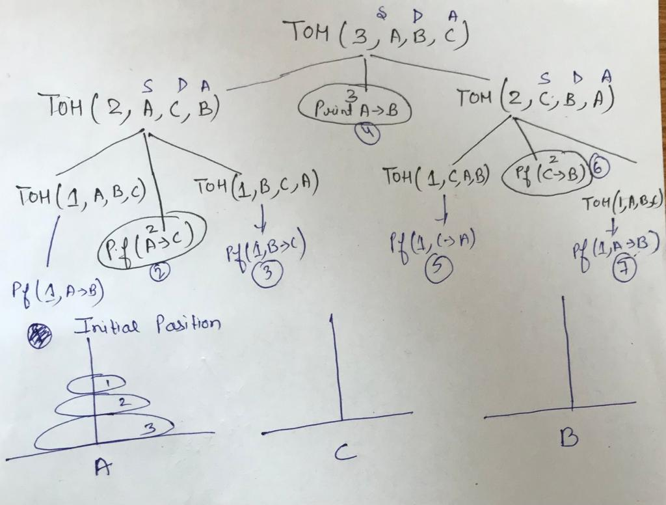
Introduction to Stack
Recursive Tree

Slide 92
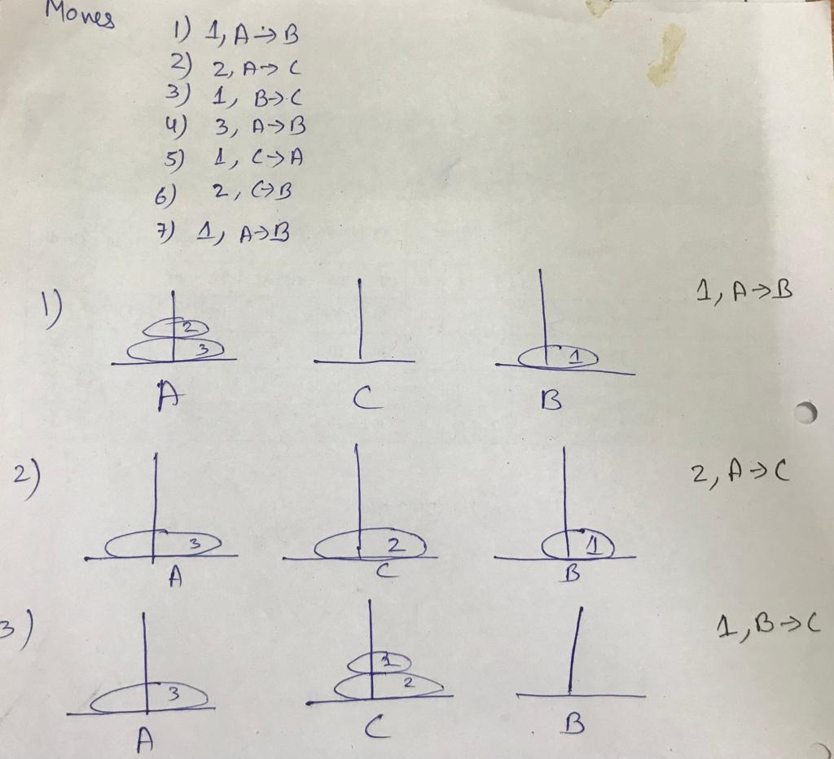
Introduction to Stack

Slide 93
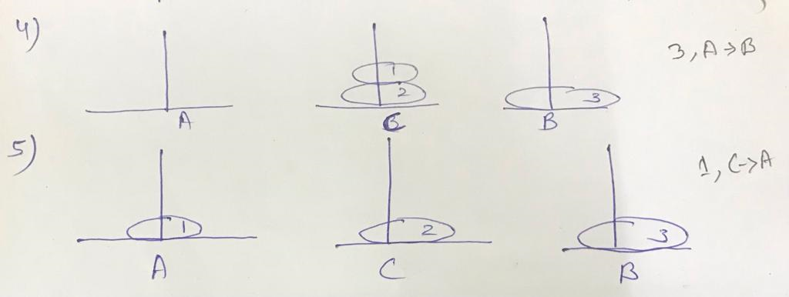
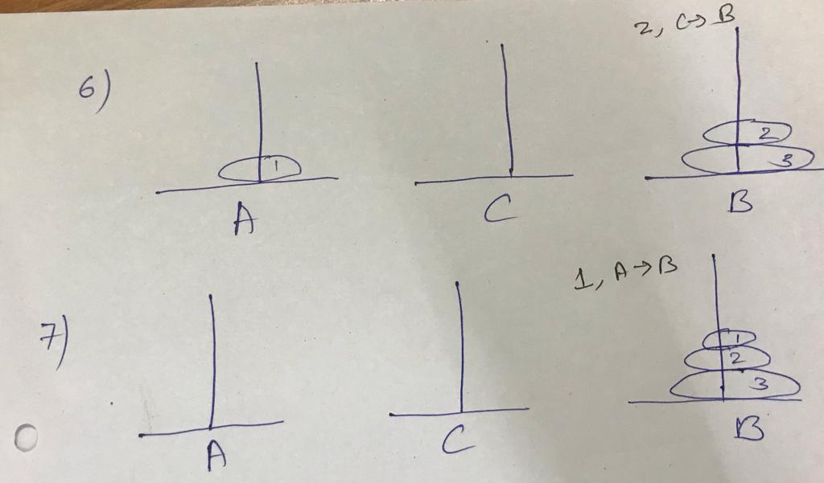
Introduction to Stack
https://www.youtube.com/watch?v=TPJQKG9zMK8
https://www.youtube.com/watch?v=KJFIm60jk0g

Slide 94
Recursion
Difference Between Recursion and Iteration
BASIS FOR COMPARISON | RECURSION | ITERATION
Basic | The statement in a body of function calls the function itself. | Allows the set of instructions to be repeatedly executed.
Format | In recursive function, only termination condition (base case) is specified. | Iteration includes initialization, condition, execution of statement within loop and update (increments and decrements) the control variable.
Termination | A conditional statement is included in the body of the function to force the function to return without recursion call being executed. | The iteration statement is repeatedly executed until a certain condition is reached.

Slide 95
Recursion
Difference Between Recursion and Iteration
BASIS FOR COMPARISON | RECURSION | ITERATION
Condition | If the function does not converge to some condition called (base case), it leads to infinite recursion. | If the control condition in the iteration statement never become false, it leads to infinite iteration.
Infinite Repetition | Infinite recursion can crash the system. | Infinite loop uses CPU cycles repeatedly.
Applied | Recursion is always applied to functions. | Iteration is applied to iteration statements or "loops".
Stack | The stack is used to store the set of new local variables and parameters each time the function is called. | Does not uses stack.
Overhead | Recursion possesses the overhead of repeated function calls. | No overhead of repeated function call.

Slide 96
Recursion
Difference Between Recursion and Iteration
BASIS FOR COMPARISON | RECURSION | ITERATION
Speed | Slow in execution. | Fast in execution.
Size of Code | Recursion reduces the size of the code. | Iteration makes the code longer.

Slide 97
Removal of Recursion
Recursion can be removed by two methods
Looping (Effective for Tail Recursion)
Using Stack Terminology

Slide 98
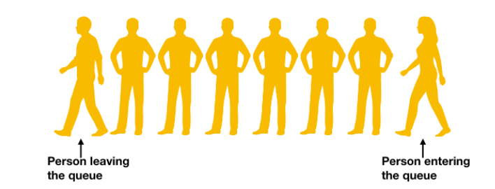
Queue
Queue
Queue is Linear Data Structure
It follows First In First Out(FIFO) principal
It has two pointers front and rear e.g.:
Front
Rear

Slide 99
Implementation of Queue
Queue
1. Using Array
2. Using Link List
Application of Queue
Queues are used in a lot of applications, few of them are:
Queue is used to implement many algorithms like Breadth First Search (BFS), etc.
It can be also used by an operating system when it has to schedule jobs with equal priority
Customers calling a call center are kept in queues when they wait for someone to pick up the calls

Slide 100
Insertion in Queue using Array
Queue
A[0]
A[1]
A[2]
A[3]
A[4]
F=R=(-1)
10
A[0]
A[1]
A[2]
A[3]
A[4]
F=R=0
10
20
A[0]
A[1]
A[2]
A[3]
A[4]
F=0
R=1

Slide 101
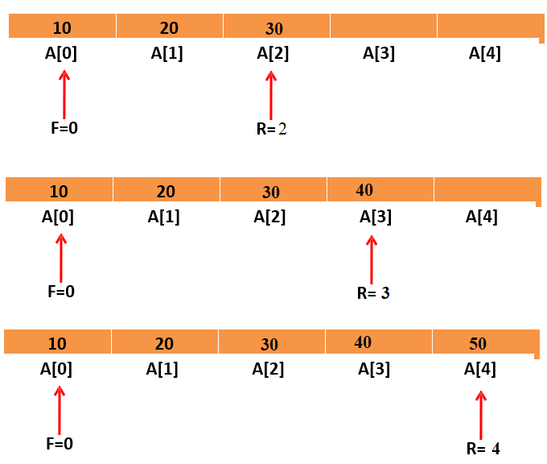
Queue

Slide 102
Operations on Queue
Queue
Insertion: Algorithm:
Step 1: If REAR = MAX – 1 then
Write “Queue is Overflow”
Goto step 4
[End of IF]
Step 2: IF FRONT=-1 and REAR=-1
SET FRONT=REAR=0
ELSE
SET REAR=REAR+1 [END OF IF]
Step 3: SET QUEUE [REAR] = NUM
Step 4: EXIT

Slide 103
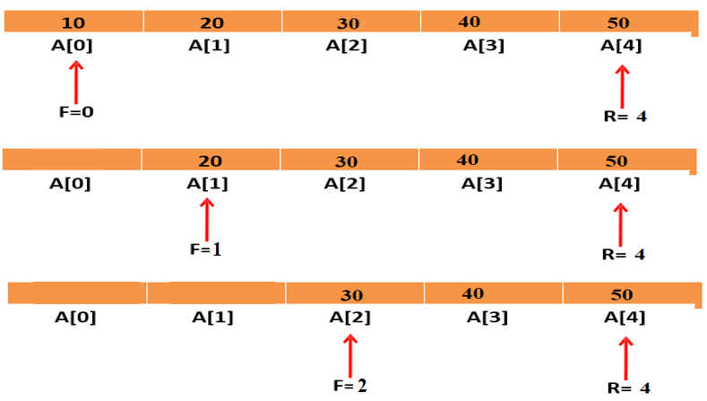
Example of Deletion in Queue
Queue
10
20
A[0]
A[1]
A[2]
A[3]
A[4]
F=0
R=1
20
A[0]
A[1]
A[2]
A[3]
A[4]
F=R=1

Slide 104
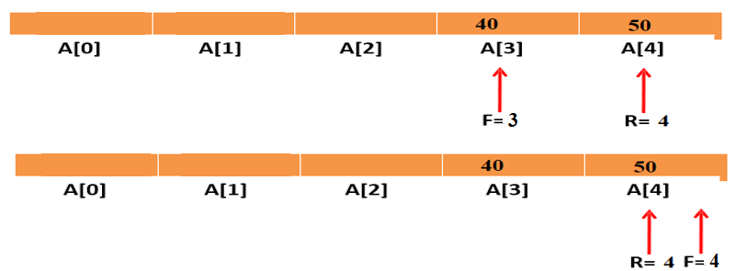
Example of Deletion in Queue
Queue
10
20
A[0]
A[1]
A[2]
A[3]
A[4]
F=0
R=1
20
A[0]
A[1]
A[2]
A[3]
A[4]
F=R=1

Slide 105
Operations on Queue
Queue
Deletion: Algorithm:
Step 1: IF FRONT = -1 OR FRONT>REAR
Write “Queue is Underflow”
ELSE
SET VAL=QUEUE [FRONT]
FRONT = FRONT + 1 [END OF IF]
Step 2: EXIT

Slide 106
Queue
Python Program
n=int(input("Enter the size of Queue:"))
A=[]
while(True):
print("Select the Operation:")
print("1.Enqueue 2.Dequeue 3. Display 4. Quit")
num = int(input())
if(num == 1):
val = int(input("Enter the element:")) A.append(val)
elif(num == 2):
A.pop(0)
elif(num == 3):
for i in range(len(A)):
print(A[i],"")
elif(num == 4):
break

Slide 107

Queue
Drawback of array implementation
Although, the technique of creating a queue is easy, but there are some drawbacks of using this technique to implement a queue.
Static Array Size
Memory wastage : The space of the array, which is used to store queue elements, can never be reused to store the elements of that queue because the elements can only be inserted at front end and the value of front might be so high so that, all the space before that, can never be filled.

Slide 108
Types Of Queue
Queue
Circular Queue
Priority Queue
Deque
Multiple Queue

Slide 109

Why Circular Queue is needed?
Queue
Problem:
– Wastage of memory in standard queue in DEQUEUE operation

Slide 110
What is Circular Queue?
Queue
The Arrangement of the elements Q[0], Q[1], ..,Q[n] in a circular fashion with Q[1] following Q[n] is called Circular Queue.
The last node is connected to first node to make a circle.
Initially, Both Front and Rear pointers points to the beginning of the array.
It is also known as “Ring Buffer”.

Slide 111


Queue

Slide 112
Insertion in circular queue
Queue
Step 1 - Check whether Circular queue is FULL. Front == (Rear+1)%Max
Step 2 - If it is FULL, then display "Queue is FULL!!! Insertion is not possible!!!" and terminate the function.
Step 3 - If it is NOT FULL, then check Front == -1,
then Front =0.
Step 4 - Rear = (Rear+1)%max, set Cqueue[Rear] = value.

Slide 113
Deletion in circular queue
Queue
Step 1 - Check whether queue is EMPTY. (front == -1)
Step 2 - If it is EMPTY, then display “Circular Queue is EMPTY!!! Deletion is not possible!!!" and terminate the function.
Step 3 - Val = Cqueue[front];
Step 4 – if(front==rear)
front = rear = -1;
Step 5 – front = (front+1)%Max;
Step 6 – return Val

Slide 114
Application of Circular Queue
Queue
Traffic light functioning is the best example for circular queues. The colors in the traffic light follow a circular pattern.
In page replacement algorithms, a circular list of pages is maintained and when a page needs to be replaced, the page in the front of the queue will be chosen.

Slide 115
Queue
display() - Displays the elements of a Circular Queue
We can use the following steps to display the elements of a circular queue...
Step 1 - Check whether queue is EMPTY. (front == -1)
Step 2 - If it is EMPTY, then display "Queue is EMPTY!!!" and terminate the function.
Step 3 - If it is NOT EMPTY, then define an integer variable 'i' and set 'i = front'.
Step 4 – for(i = front; i!=rear; i = (i+1)%Max)
Print Cqueue[i];
end
print(queue[rear]);
Step 5 - Exit

Slide 116
Queue
Python program to implement circular queue
def getInput():
return int(input("Select a operarion 1.Enqueue 2.Dequeue 3.Display 4.Quit "))
class circularQueue():
def __init__(self,size):
self.size=size
self.queue=[None for i in range(size)]
self.front=self.rear= -1
def enqueue(self):
data=int(input("Enter Element "))
if(self.rear+1)%self.size==self.front:
print(" Queue is Full")
elif self.front== -1:
self.front=0
self.rear=0
self.queue[self.rear]=data
else:
self.rear=(self.rear+1)%self.size
self.queue[self.rear]=data

Slide 117
Queue
Python program to implement circular queue (cont….)
def dequeue(self):
if self.front== -1:
print("Queue is Empty")
elif self.front == self.rear:
self.front = -1
self.rear = -1
print("Element is Successfully Removed")
else:
self.front=(self.front+1)%self.size
print("Element is Successfully Removed")

Slide 118
Queue
Python program to implement circular queue (cont….)
def display(self):
if self.front== -1:
print("Queue is Empty")
elif self.rear >= self.front:
print("Elements in the circular Queue are:")
for i in range(self.front,self.rear+1):
print(self.queue[i])
else:
print("Elements in the circular queue are:")
for i in range(self.front,self.size):
print(self.queue[i])
for i in range(0,self.rear+1):
print(selff.queue[i])
if(self.rear+1)%self.size==self.front:
print("Queue is Full")

Slide 119
Queue
Python program to implement circular queue (cont….)
size=int(input("Enter size of Queue "))
q=circularQueue(size)
while True:
op=getInput()
if op==1:
q.enqueue()
elif op==2:
q.dequeue()
elif op==3:
q.display()
else:
break

Slide 120
Priority Queue
Queue
In priority queue, each element is assigned a priority.
Priority of an element determines the order in which the elements will be processed.
Rules:
An element with higher priority will processed before an element with a lower priority.
Two elements with the same priority are processed on a First Come First Serve basis.

Slide 121
Queue
Priority Queue
DATA | PRIORTY NUMBER
A | 5
B | 1
D | 3
E | 2
F | 8
G | 6

Slide 122
Types of Priority Queue
Queue
Ascending Priority Queue
In this type of priority queue, elements can be inserted into any order but only the smallest priority element can be removed.
Descending Priority Queue
In this type of priority queue, elements can be inserted into any order but only the largest priority element can be removed.

Slide 123
Array Representation of Priority Queue
Queue
Insertion Operation:
While inserting elements in priority queue we will add it at the appropriate position depending on its priority
It is inserted in such a way that the elements are always ordered either in Ascending or descending sequence

Slide 124
Queue
Array Insertion of Priority Queue
DATA | PRIORTY NUMBER
A | 5
B | 1
D | 3
E | 2
F | 8
G | 6
DATA | PRIORTY NUMBER
B | 1
E | 2
D | 3
A | 5
G | 6
F | 8

Slide 125
Array Representation of Priority Queue
Queue
Deletion Operation:
While deletion, the element at the front is always deleted.
DATA | PRIORTY NUMBER
B | 1
E | 2
D | 3
A | 5
G | 6
F | 8

Slide 126

Python Program to implement priority queue using List
Queue
Here we set- Lower is the number higher is the priority.
This method is costly. Its not a best way to implement priority queue. Best way to implement it is using priority queue class in python.

Slide 127

Python program to implement priority queue using Priority-Queue Class
Queue
Here we set- Lower is the number higher is the priority.

Slide 128

Python Program - Priority Queue implementation using tuple
Queue
* Tuple is used to set priority of data

Slide 129
Application of Priority Queue
Queue
Prim's algorithm implementation can be done using priority queues.
Dijkstra's shortest path algorithm implementation can be done using priority queues.
A* Search algorithm implementation can be done using priority queues.
Priority queues are used to sort heaps.
Priority queues are used in operating system for load balancing and interrupt handling.
Priority queues are used in huffman codes for data compression.
In traffic light, depending upon the traffic, the colors will be given priority.

Slide 130
Deque / Double Ended Queue
Queue
A list in which elements can be inserted or deleted either end
It is also known as “Head-Tail Linked List”
It has two pointers LEFT and RIGHT, which point to either end of the deque.
Deque (Doubly Ended Queue) in Python is implemented using the module “collections“. Deque is preferred over a list in the cases where we need quicker append and pop operations from both the ends of the container, as deque provides an O(1) time complexity for append and pop operations as compared to a list that provides O(n) time complexity.

Slide 131
Types of Deque
Queue
Input Restricted Deque:-
In this dequeue, insertion can be done only at one of the end, while deletion can be done from both ends.
Output Restricted Deque:-
In this dequeue, deletion can be done only at one of the ends, while insertions can be done on both ends

Slide 132

Queue
Input Restricted Deque

Slide 133

Queue
Output Restricted Deque

Slide 134

Queue
# importing "collections" for deque operations
import collections
# initializing deque
de = collections.deque([1, 2, 3])
print("deque: ", de)
# using append() to insert element at right end
# inserts 4 at the end of deque
de.append(4)
# printing modified deque
print("\nThe deque after appending at right is : ")
print(de)
# using appendleft() to insert element at left end inserts 6 at the beginning of deque
de.appendleft(6)
# printing modified deque
print("\nThe deque after appending at left is : ")
print(de)

Slide 135

Queue
# importing "collections" for deque operations
import collections
# initializing deque
de = collections.deque([1, 2, 3])
print("deque: ", de)
# using pop() to delete element from right end
# deletes 4 from the right end of deque
de.pop()
# printing modified deque
print("\nThe deque after deleting from right is : ")
print(de)
# using popleft() to delete element from left end
# deletes 6 from the left end of deque
de.popleft()
# printing modified deque
print("\nThe deque after deleting from left is : ")
print(de)

Slide 136
Queue
Application of Deque – Deque is a Double Ended Queue where operations(Add/Remove) can be made on both ends of the queue.
A web browser's history. Recently visited URLs are added to the front of the deque, and the URL at the back of the deque is removed after some specified number of insertions at the front.
Another common application of the deque is storing a software application's list of undo operations.
Have you see moneyControl App, it will show the stocks you last visited, it will remove the stocks after some time and will add the latest ones.

Slide 137
Faculty Video Links, YouTube & NPTEL Video Links and Online Courses Details
Self Made Video Link:
Youtube/other Video Links
https://www.youtube.com/watch?v=8e_PwxYGZrA&list=PLzgPDYo_3xukPJdH6hVQ6Iic7KiJuoA-l
https://www.youtube.com/watch?v=_t2GVaQasRY&list=PLeo1K3hjS3uu_n_a__MI_KktGTLYopZ12
https://www.youtube.com/watch?v=pkYVOmU3MgA&t=22062s

Slide 138
Daily Quiz
What is Stack and where it can be used?
What is a Queue, how it is different from stack and how is it implemented?
What are Infix, prefix, Postfix notations?
How to implement a stack using queue?
How to implement a queue using stack?
What is recursion and when should you use it?
Write a function to copy string (Iterative and Recursive).
Check if a number is Palindrome using recursion
Reverse a stack using recursion.
Sort a stack using recursion.

Slide 139
Weekly Assignment
Q 1 What do you understand by stable and in place sorting?
Q 2 Consider the following infix expression and convert into reverse polish notation using stack. A + (B * C – (D / E ^ F) * H)
Q3 Recursive function to delete k-th node from linked list.
Q4. Write the python Program to implement queue using stack.
Q5. The initial configuration of a queue is p,q,r,s (‘p’ is in the front end ). To get the configuration s,r,q,p, how many minimum dequeue and enqueue are required?

Slide 140
MCQ s
1. Process of inserting an element in stack is called ____________
a) Create
b) Push
c) Evaluation
d) Pop
2. Process of removing an element from stack is called __________
a) Create
b) Push
c) Evaluation
d) Pop

Slide 141
MCQ s
3. In a stack, if a user tries to remove an element from empty stack it is called _________
a) Underflow
b) Empty collection
c) Overflow
d) Garbage Collection
4. Pushing an element into stack already having five elements and stack size of 5, then stack becomes
a) Overflow
b) Crash
c) Underflow
d) User flow

Slide 142
MCQ s
5. Which of the following applications may use a stack?
a) A parentheses balancing program
b) Tracking of local variables at run time
c) Compiler Syntax Analyzer
d) Data Transfer between two asynchronous process
6. 1. Recursion is a method in which the solution of a problem depends on ____________
a) Larger instances of different problems
b) Larger instances of the same problem
c) Smaller instances of the same problem
d) Smaller instances of different problems

Slide 143
MCQ s
7. Recursion is similar to which of the following? a) Switch Case b) Loop c) If-else d) if elif else
8. A queue follows __________ a) FIFO (First In First Out) principle b) LIFO (Last In First Out) principle c) Ordered array d) Linear tree

Slide 144
MCQ s
9. If the elements “A”, “B”, “C” and “D” are placed in a queue and are deleted one at a time, in what order will they be removed? a) ABCD b) DCBA c) DCAB d) ABDC
10. A data structure in which elements can be inserted or deleted at/from both the ends but not in the middle is? a) Queue b) Circular queue c) Dequeue d) Priority queue

Slide 145
Expected Questions for University Exam
Q1. Define priority queue.
Q2. Write a program in C for implementation of a queue. Your program should at least contain ADD, CREATE. DELETE, FULL and EMPTY functions.
Q3. If an array is defined as int a[10] [20] in C, devise a formula to calculate the address of an any variable say a[i] [j], for any valid value of i and j.
Q4. Write a program to implement STACK using linked list.
Q5. If the Tower of Hanoi is operated on n=10 disks, calculate the total number of moves.
Q6. Differentiate between overflow and underflow condition in a linked list.

Slide 146
Expected Questions for University Exam
Q7. Convert the following infix expression into postfix expression:
B-C/D+A*(F-G/H).
Q8.Write a program in python to compute the factorial of given number recursively.
Q9.Write a Program in python to implement all operations of a Stack using array.
Q10.Define Dequeue.
Q11. Write the syntax to check whether a given circular queue is full or empty?
Q12. What is Recursion? Give disadvantages of recursion.
Q13.Explain Tower of Hanoi problem and write a recursive algorithm to solve it.
Q14. Explain how a circular queue can be implemented using arrays. Write all functions for circular queue operations.

Slide 147
Old Question Papers
https://drive.google.com/open?id=15fAkaWQ5ccZRZPzwlP4PBh1LxcPp4VAd

Slide 148
Summary
We consider two fundamental data types for storing collections of objects: the stack and the queue.
We implement each using either a singly-linked list or a resizing array.
We introduce two advanced Java features—generics and iterators—that simplify client code.
Finally, we consider various applications of stacks and queues ranging from parsing arithmetic expressions to simulating queueing systems.

Slide 149
References
[1] Aaron M. Tenenbaum, Yedidyah Langsam and Moshe J. Augenstein, “Data Structures Using C and C++”, PHI Learning Private Limited, Delhi India
[2] Horowitz and Sahani, “Fundamentals of Data Structures”, Galgotia Publications Pvt Ltd Delhi India.
[3] Lipschutz, “Data Structures” Schaum’s Outline Series, Tata McGraw-hill Education (India) Pvt. Ltd.
[4] Thareja, “Data Structure Using C” Oxford Higher Education.
[5] AK Sharma, “Data Structure Using C”, Pearson Education India.

Slide 150
Thank you

